Slide 1
Particle photon weather station Part 1 of 6: Overview & Event Hub Setup
Particle Photon + DHT11 Sensor + Azure + Power BI + Node.js + .NET = AWESOME

Slide 2
Grab the slides & code:
http://aka.ms/ppws

Slide 3
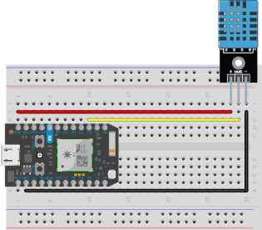
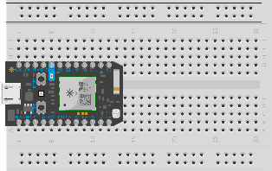
Solution ARCHITECTURE
<name>data
Power BI Data Set
Send
<name>job
Stream Analytics Job
<name>-ns Service Bus Namespace
Receive
Logging
<name>hub
Event Hub
<name>storage
Storage Account
SEND
PublishWeather Web Hook
Receive
Receive
ChkPt
“NodeReceiver”
Node.JS Receiver App
“DotNetReceiver”
.NET C# Console App Receiver

Slide 4
Solution ARCHITECTURE
<name>-ns Service Bus Namespace
<name>hub
Event Hub

Slide 5
Azure event hubs

Slide 6
Create the Azure Event Hub

Slide 7
Particle photon weather station Part 2 of 6: Particle Cloud and photon Prep
Particle Photon + DHT11 Sensor + Azure + Power BI + Node.js + .NET = AWESOME

Slide 8
Grab the slides & code:
http://aka.ms/ppws

Slide 9
Solution ARCHITECTURE
<name>data
Power BI Data Set
Send
<name>job
Stream Analytics Job
<name>-ns Service Bus Namespace
Receive
Logging
<name>hub
Event Hub
<name>storage
Storage Account
SEND
PublishWeather Web Hook
Receive
Receive
ChkPt
“NodeReceiver”
Node.JS Receiver App
“DotNetReceiver”
.NET C# Console App Receiver

Slide 10
Solution ARCHITECTURE
<name>-ns Service Bus Namespace
“DeviceHub”
Event Hub
PublishWeather Web Hook

Slide 11
Configure the Particle Cloud and Photon

Slide 12
Particle photon weather station Part 3 of 6: Photon DTH11 Circuit & Sketch
Particle Photon + DHT11 Sensor + Azure + Power BI + Node.js + .NET = AWESOME

Slide 13
Grab the slides & code:
http://aka.ms/ppws

Slide 14
Solution ARCHITECTURE
SensorData Data Set
Power BI
Send
“PowerBIDump”
Stream Analytics Job
<name>-ns Service Bus Namespace
Receive
Logging
“DeviceHub”
Event Hub
“<name>storage”
Storage Account
SEND
PublishWeather Web Hook
Receive
Receive
ChkPt
“NodeReceiver”
Node.JS Receiver App
“DotNetReceiver”
.NET C# Console App Receiver

Slide 15
Solution ARCHITECTURE
<name>-ns Service Bus Namespace
SEND
“DeviceHub”
Event Hub
PublishWeather Web Hook

Slide 16
Create the Photon DHT11 Circuit & Code

Slide 17
Particle photon weather station Part 4 0f 6: Reporting with Power BI
Particle Photon + DHT11 Sensor + Azure + Power BI + Node.js + .NET = AWESOME

Slide 18
Grab the slides & code:
http://aka.ms/ppws

Slide 19
Solution ARCHITECTURE
SensorData Data Set
Power BI
Send
“PowerBIDump”
Stream Analytics Job
<name>-ns Service Bus Namespace
Receive
Logging
“DeviceHub”
Event Hub
“<name>storage”
Storage Account
SEND
PublishWeather Web Hook
Receive
Receive
ChkPt
“NodeReceiver”
Node.JS Receiver App
“DotNetReceiver”
.NET C# Console App Receiver

Slide 20
Solution ARCHITECTURE
SensorData Data Set
Power BI
Send
“PowerBIDump”
Stream Analytics Job
<name>-ns Service Bus Namespace
Receive
Logging
“DeviceHub”
Event Hub
“<name>storage”
Storage Account
SEND
PublishWeather Web Hook

Slide 21
Reporting with Power BI

Slide 22
Particle photon weather station Part 5 of 6: RECEIVING EVENTS with Node.js
Particle Photon + DHT11 Sensor + Azure + Power BI + Node.js + .NET = AWESOME

Slide 23
Grab the slides & code:
http://aka.ms/ppws

Slide 24
Solution ARCHITECTURE
SensorData Data Set
Power BI
Send
“PowerBIDump”
Stream Analytics Job
<name>-ns Service Bus Namespace
Receive
Logging
“DeviceHub”
Event Hub
“<name>storage”
Storage Account
SEND
PublishWeather Web Hook
Receive
Receive
ChkPt
“NodeReceiver”
Node.JS Receiver App
“DotNetReceiver”
.NET C# Console App Receiver

Slide 25
Solution ARCHITECTURE
SensorData Data Set
Power BI
Send
“PowerBIDump”
Stream Analytics Job
<name>-ns Service Bus Namespace
Receive
Logging
“DeviceHub”
Event Hub
“<name>storage”
Storage Account
SEND
PublishWeather Web Hook
Receive
“NodeReceiver”
Node.JS Receiver App

Slide 26
Receiving Events Hub Messages with Node.js

Slide 27
Particle photon weather station Part 6 of 6: RECEIVING EVENTS with C#
Particle Photon + DHT11 Sensor + Azure + Power BI + Node.js + .NET = AWESOME

Slide 28
Grab the slides & code:
http://aka.ms/ppws

Slide 29
Solution ARCHITECTURE
SensorData Data Set
Power BI
Send
“PowerBIDump”
Stream Analytics Job
<name>-ns Service Bus Namespace
Receive
Logging
“DeviceHub”
Event Hub
“<name>storage”
Storage Account
SEND
PublishWeather Web Hook
Receive
Receive
ChkPt
“NodeReceiver”
Node.JS Receiver App
“DotNetReceiver”
.NET C# Console App Receiver

Slide 30
Solution ARCHITECTURE
SensorData Data Set
Power BI
Send
“PowerBIDump”
Stream Analytics Job
<name>-ns Service Bus Namespace
Receive
Logging
“DeviceHub”
Event Hub
“<name>storage”
Storage Account
SEND
PublishWeather Web Hook
Receive
Receive
ChkPt
“NodeReceiver”
Node.JS Receiver App
“DotNetReceiver”
.NET C# Console App Receiver

Slide 31
Receiving Events Hub Messages with .NET

Slide 32
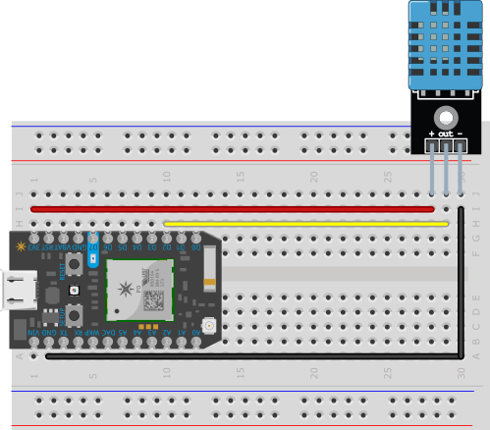
Architecture overview
PublishWeather Web Hook
DeviceHub Event Hub
PowerBIDump Stream Analytics Job
WeatherData Power BI Data Set

Slide 33
Architecture overview
PublishWeather Web Hook
DeviceHub Event Hub
PowerBIDump Stream Analytics Job
SensorData Power BI Data Set

Slide 34
Power BI LOGO

Slide 35
IoT Logo

Slide 36
arduino

Slide 37
GALILEO BOARD

Slide 38
RASPBERRY PI

Slide 39
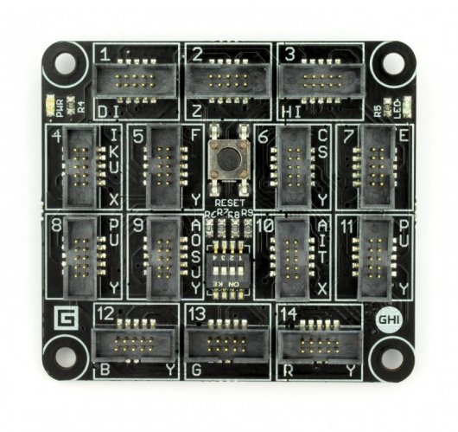
FEZ SPIDER MAIN BOARD

Slide 40
Sparkfun weather shield

Slide 41
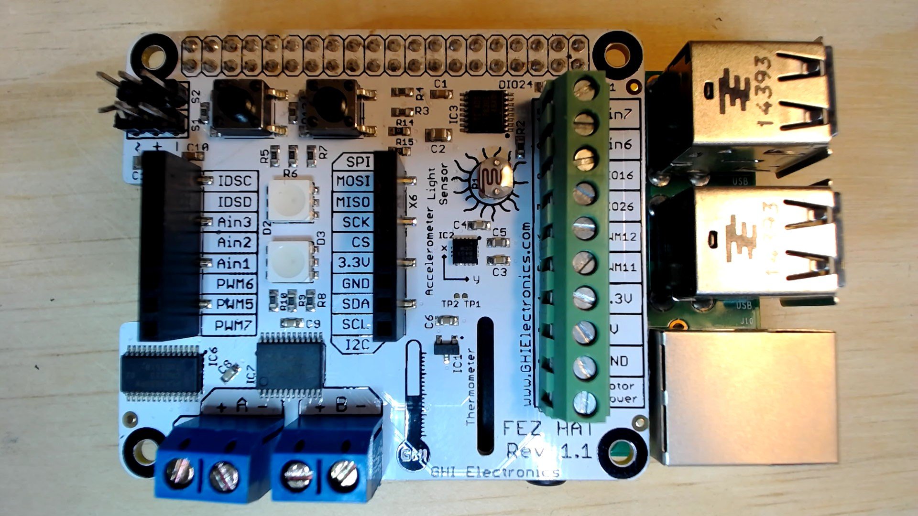
FEZ HAT

Slide 42
Connect the dots azure icons
Event Hubs
Stream Analytics
Storage
(
Azure
Microsoft Azure
Web App
Service Bus
)
Storage blob
Storage table
SQL database
HDInsight
Machine
(
Learning
GitHub code
Git repository
generic
)

Slide 43
LEDs

Slide 44
Resistors
220Ω
1st Digit
2nd Digit
Multiplier
Tolerance
Color | Name | 1st Digit | 2nd Digit | Multiplier | Tolerance
 | Black | 0 | 0 | X1
 | Brown | 1 | 1 | X10 | 1%
 | Red | 2 | 2 | X100
 | Orange | 3 | 3 | X1,000
 | Yellow | 4 | 4 | X10,000
 | Green | 5 | 5 | X100,000
 | Blue | 6 | 6 | X1,000,000
 | Violet | 7 | 7
 | Grey | 8 | 8
 | White | 9 | 9
 | Gold |  |  | X0.1 | 5%
 | Silver |  |  | X0.01 | 10%
330Ω
10KΩ

Slide 45
cables

Slide 46
More cables and adapters

Slide 47

LEDs
Anode (+)
Cathode (-)
Flat Edge
Small Post
Big Post
Long Leg
Short Leg
Vcc (+)
GND

Slide 48
LEDs

Slide 49
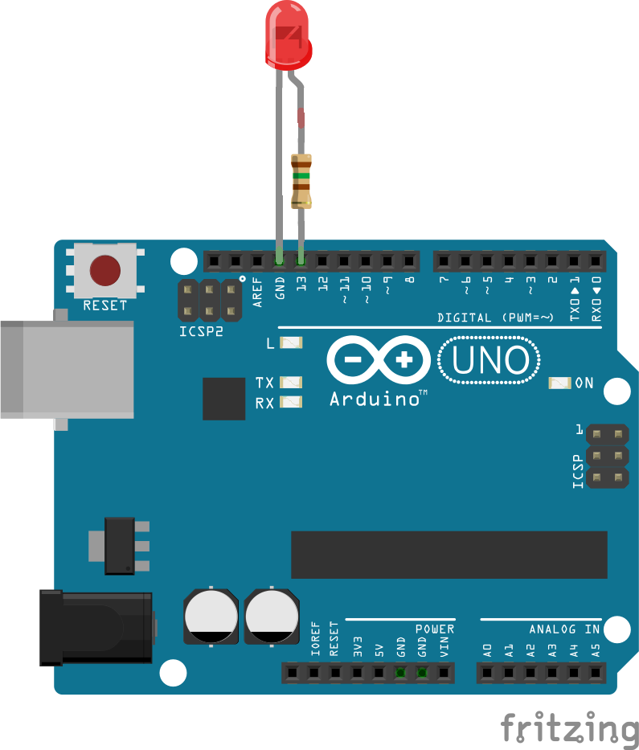
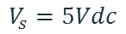
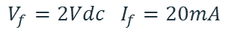
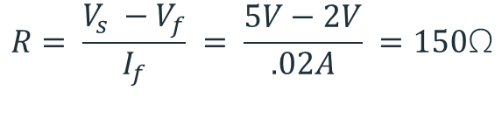
Current limiting resistors
Providing more current than an LED is rated for can destroy the LED. To prevent that, you should use a “Current Limiting” resistor.
To calculate the value of the resistor you need to know the supply voltage (Usually 5V on the Arduino Uno), and the LEDs rated Forward Voltage (the voltage drop across the LED) and Forward Current (the maximum current the LED can handle).
$$V_{f}=2Vdc I_{f}=20mA$$
$$Resistor Value (R)= \frac{Supply Voltage \left(V_{s}\right)−LED Forward Voltage (V_{f}) }{LED Forward Current (I_{f})}$$
$$V_{s}=5Vdc$$
$$R= \frac{V_{s} −V_{f}}{I_{f}} = \frac{5V−2V}{.02A} =150\text{Ω}$$
The Arduino Uno has a built in current limiting resistor on Pin 13. If you use Pin 13 to power your LED you can use it without a separate resistor.

Slide 50
Resistors
220Ω
1st Digit
2nd Digit
Multiplier
Tolerance
Color | Name | 1st Digit | 2nd Digit | Multiplier | Tolerance
 | Black | 0 | 0 | X1
 | Brown | 1 | 1 | X10 | 1%
 | Red | 2 | 2 | X100
 | Orange | 3 | 3 | X1,000
 | Yellow | 4 | 4 | X10,000
 | Green | 5 | 5 | X100,000
 | Blue | 6 | 6 | X1,000,000
 | Violet | 7 | 7
 | Grey | 8 | 8
 | White | 9 | 9
 | Gold |  |  | X0.1 | 5%
 | Silver |  |  | X0.01 | 10%
330Ω
10KΩ

Slide 51
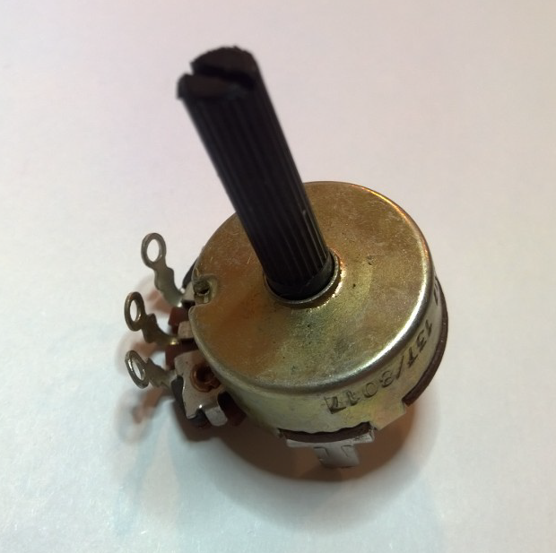
Potentiometer – variable resistor

Slide 52
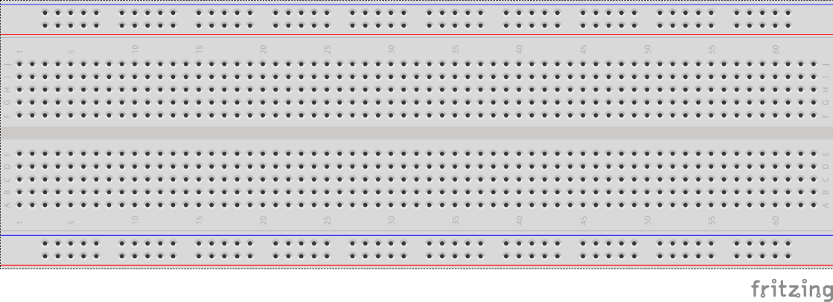
breadboards
Breadboards offer a great way to prototype circuits. The provide a number of “buses” for connecting both power and components.
Power buses run the entire horizontal length
Component buses give you easy ways to connect pins together

Slide 55
Micro SD Cards
Font: Segoe UI Semibold

